Slide 1
Volume Tiled Forward Shading
Jeremiah van Oosten – 3910539 - INFOMGMT

Slide 2
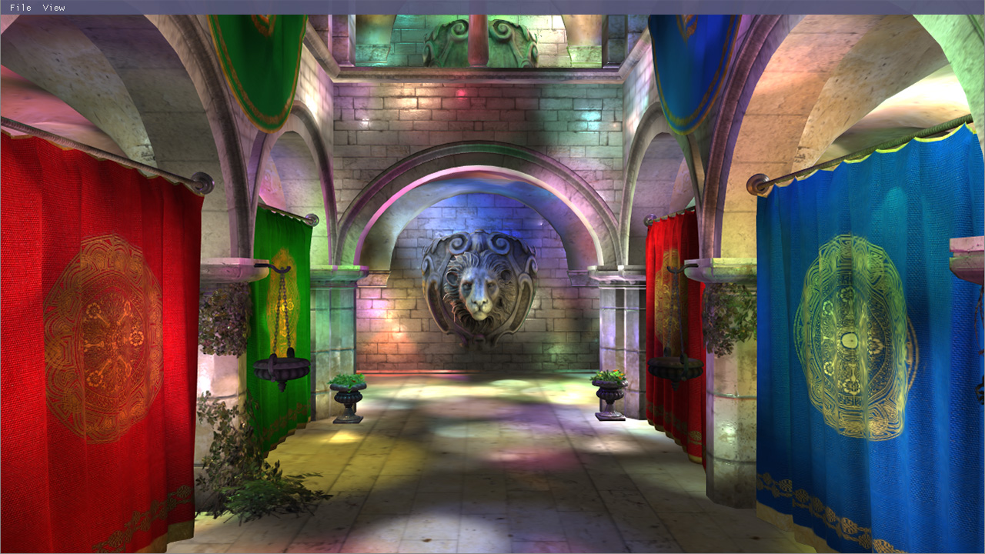
Abstract
Volume Tiled Forward Shading extends upon Tiled and Clustered Forward Shading (Ola Olsson et. al.)
Goal is to increase the number of lights in the scene
Can achieve 4 million light source in real-time (30 FPS)
Notes:
In order to achieve a greater degree of visual fidelity, graphics programmers are constantly seeking methods to push the limits of what is possible in graphics hardware. In this thesis, we describe Volume Tiled Forward Shading, a new lighting technique based on Tiled Forward and Clustered Forward Shading from Ola Olsson et. al. Is it possible to render a scene which contains millions of active light source in real-time on commodity desktop hardware? To answer this question, an experiment was executed in order to demonstrate Volume Tiled Forward Shading. In the experiment, a typical 3D scene was loaded and millions light sources were randomly
placed within the scene. This thesis shows that a scene containing 4,000,000 light sources can be rendered in real-time using Volume Tiled Forward Shading. Volume Tiled Forward Shading proves to be a viable technique to achieve real-time frame rates in scenes containing many light sources.

Slide 3
Background
Forward Rendering
Deferred Shading
Tiled Forward Shading
Clustered Forward Shading

Slide 4
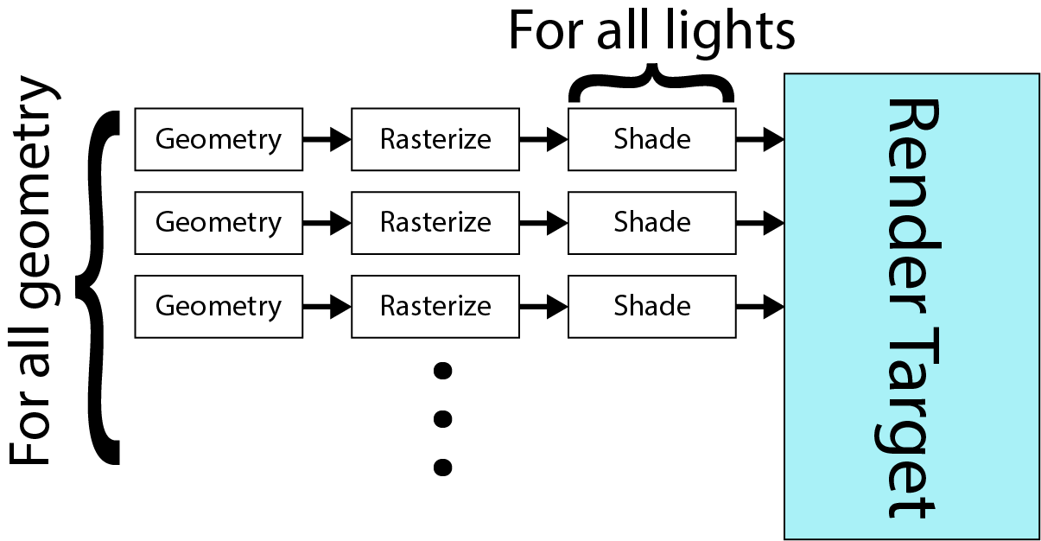

Forward Rendering
Geometry is pushed “forward” through the rendering pipeline.
Vertex transformations, texturing & lighting performed in a single pass.
$O\left(gfl\right)$ runtime where:
$g$ is the number of geometric objects to render
$f$ is the number of fragments that are shaded
$l$ is the number of lights in the scene
Notes:
Pros:
Simple to implement
Minimal overhead (buffers, I/O transfers)
Support for MSAA
Support for multiple materials
Cons:
Every light is considered during shading
Does not support many lights
Scales poorly with resolution / scene complexity

Slide 5
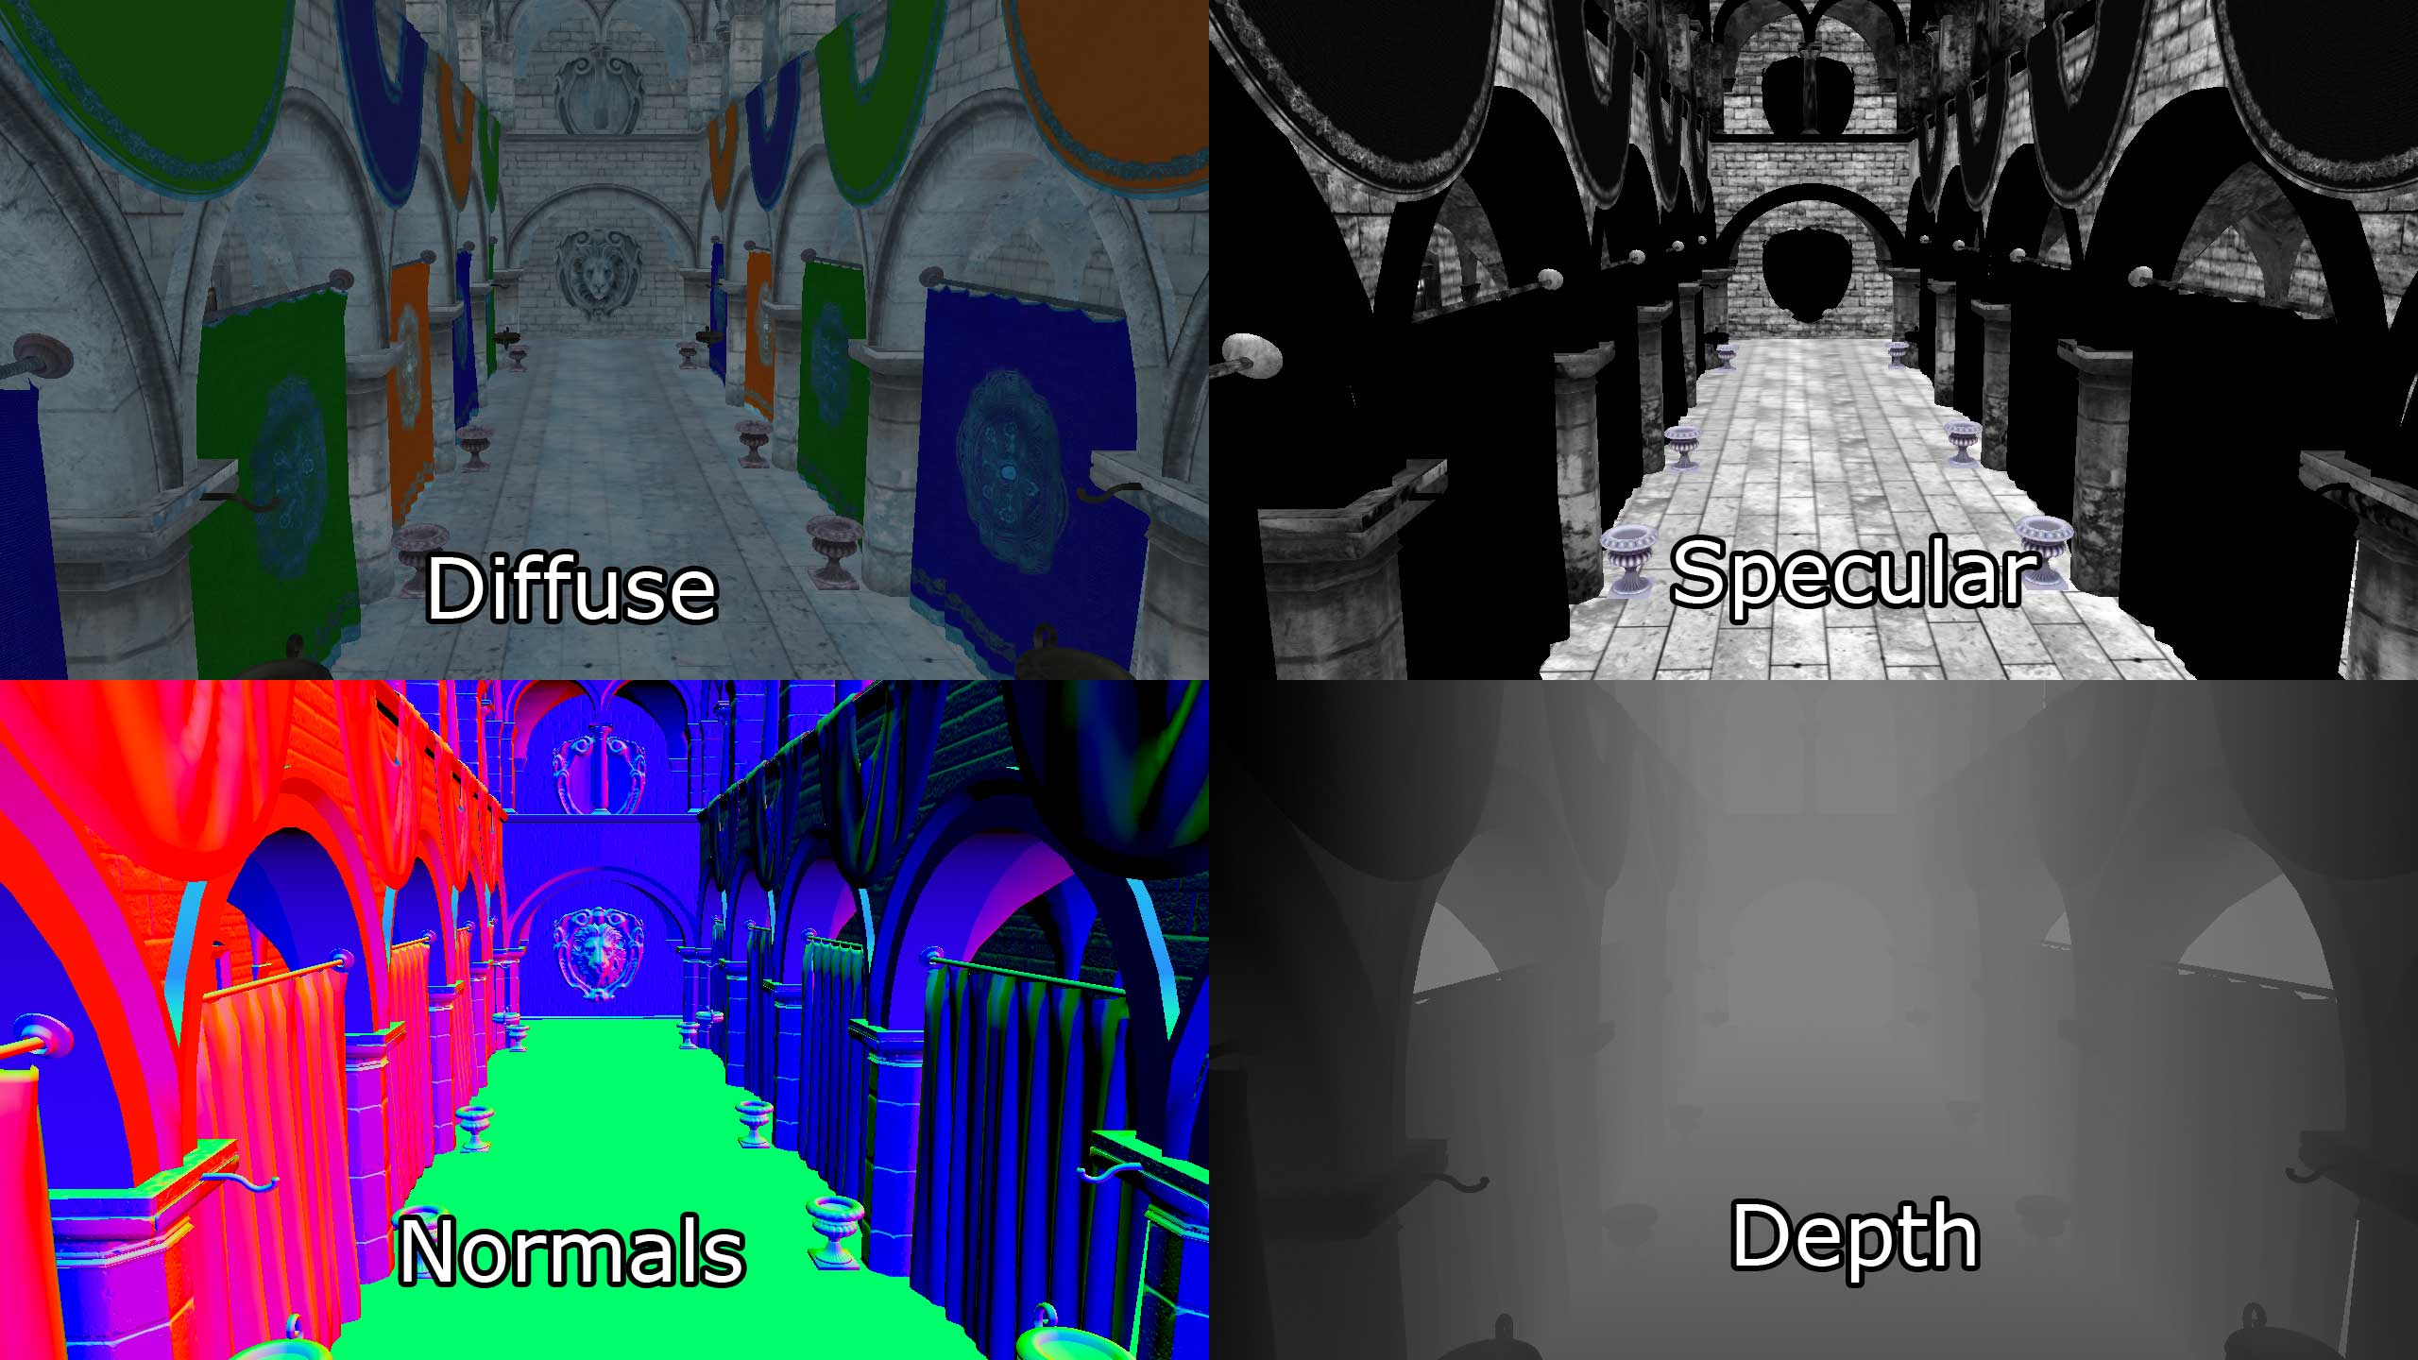
Deferred Shading
Builds geometry buffers (G-buffers) to store attributes
Depth/Stencil
Light Accumulation
Normals
Specular
Lambert Diffuse
Lighting is computed in the second pass
Lights rendered as shapes
Point lights as spheres
Spot lights as cones
Directional lights as full-screen quads
Notes:
Pros:
Reduces unnecessary lighting calculations due to overdraw.
Supports many more lights than forward rendering.
Cons:
Additional overhead required for G-buffers
Increased I/O resulting from additional texture reads (can be improved by packing data better but this is never really resolved)
Each light requires a draw call (can use instanced rendering, but still has some overhead)
Only supports opaque geometry
Only support for single material shader (more attributes could be used to support different materials, but this results in more I/O & buffer storage)
Transparent materials required forward rendering pass (limits light counts)
No support for native AA effects (MSAA) because MSAA render targets need to be resolved before lighting can be performed (or hacky to implement and only worsens the I/O problem)

Slide 6
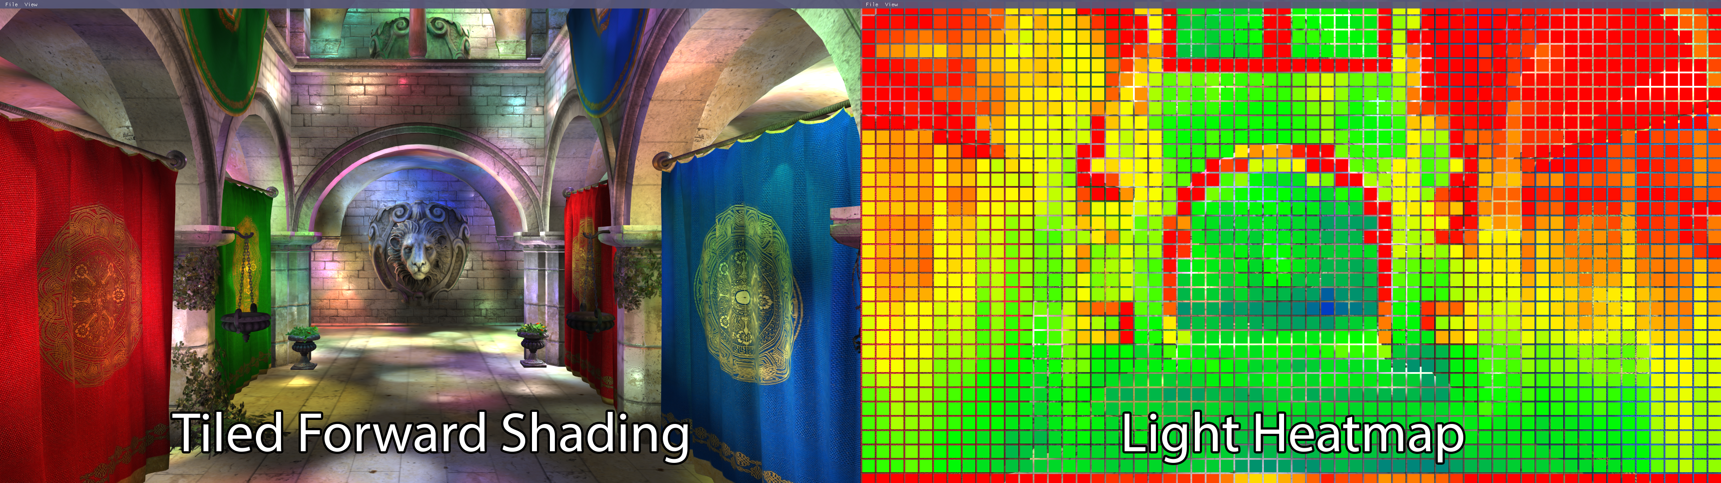
Tiled Forward Shading
Tiled Forward Shading
Splits the screen into uniform screen-space tiles
Each tile forms a frustum (in view space)
Lights are assigned to tiles by performing frustum culling
When shading, only lights inside the tile’s frustum are considered
Notes:
Pros:
Doesn’t require additional buffers for geometric attributes
Can handle many more lights compared to Forward & Deferred
Support for MSAA
Support for multiple materials
Cons:
False positives at geometric boundaries due to elongated frustums
Frustum culling can result in many false positives (may be improved using separating axis theorem (SAT), but this was not investigated)

Slide 7
Clustered Forward Shading
Clusters samples based on position and normal
Cluster keys are written to 2D image buffer
Cluster keys are sorted and compacted to find unique keys
Lights are assigned to unique clusters
Only lights inside cluster’s AABB need to be considered during shading
Notes:
Pros:
Reduces false positives at geometric boundaries
Culling is improved since (AABB instead of Frustum culling)
Native support for MSAA
Cons:
Cluster buffer uses 2D image buffer – does not consider transparent objects (requires a 3D image buffer for this)

Slide 8
GPU Architecture
Thread Dispatch
Coalesced Access to Global Memory
Avoid Bank Conflicts to Shared Memory

Slide 9
Thread Dispatch
Work is executed in a grid
Thread groups consist of threads
High-speed memory is shared within a thread group
Synchronization only possible between threads in a thread group
Synchronization amongst thread groups only possible by a separate dispatch

Slide 10
Coalesced Access to Global Memory
Fetches to global memory is slow
Coalesced access reduces the number of fetches required
Global memory is accessed via memory segments
The size of a segment is dependent on the size of a word accessed by each thread in a warp
32 B for 1 B words
64 B for 2 B words
128 B for 4, 8, and 16 B words
Notes:
Coalescing will occur when the k^{th} thread in a warp accesses the k^{th} word in a memory segment. If each thread in the warp sequentially accesses a 1 B value from global memory, this will result a single memory transaction of 32 B. If each thread in the warp accesses a 16 B (4-component floating-point) value from global memory, this will result in 4 128 B memory transactions (one for each quarter-warp).

Slide 11
Avoid Bank Conflicts to Shared Memory
Shared memory is stored in 32 banks of 32-bit words
If each thread in a warp accesses a different memory bank then no conflicts occur and all reads / writes happen simultaneously

Slide 12
Parallel Primitives
Reduction
Scan
Notes:
The parallel reduction and parallel scan operations are fundamental building blocks for other parallel algorithms such as sorting.

Slide 13

Parallel Reduction
A Reduction applies a binary associative operator ($⊕$) over a set of $n$ values, reducing to a single value.
$$\sum_{i=0}^{n}{a_{i}=a_{0}⊕a_{1}⊕a_{2}⋯⊕a_{n}}$$
Using Interleaved log-step reduction avoids shared memory bank conflicts when the addresses are accessed in an interleaved pattern
$$\left(\left(\left(a_{0}⊕a_{4}\right)⊕\left(a_{1}⊕a_{5}\right)\right)⊕\left(\left(a_{2}⊕a_{6}\right)⊕\left(a_{3}⊕a_{7}\right)\right)\right)$$
Notes:
Serial reduction requires (n-1) passes to reduce to a single value. This is commonly used when the reduction is preformed on a single thread.
Pair-wise log-step reduction takes log_2(n) steps but results in bank conflicts when accessing shared memory.
Interleaved log-step reduction also takes log_2(n) steps but avoids bank conflicts when accessing the data in an interleaved pattern.

Slide 14

Parallel Scan
Takes a binary operator ($⊕$) and identity ($i_{⊕}$) and an ordered set $[a_{0},a_{1},a_{2},⋯,a_{n−1}]$ of $n$ elements and returns the ordered set $\left[i_{⊕},a_{0},\left(a_{0}⊕a_{1}\right),⋯,\left(a_{0}⊕a_{1}⊕⋯⊕a_{n−2}\right)\right]$
$i_{⊕}$ is $0$ for addition and $1$ for multiplication
For example, if $⊕$ is addition, then the scan applied to the array:
$$[2,1,2,3,4,8,13,21]$$
Would produce
$$[0,2,3,5,8,12,20,33]$$
Notes:
In the first step, the output array y is primed by copying all of the elements from the input array (x) to the output array (y) shifted one index to the right. A loop is iterated log_2(n) times and for each thread whose thread ID is greater than 2^i where i is the loop iteration counter, the sum
of y[tid] y[tid – 2^i] is computed and stored at y[tid] where tid is the ID of
the thread in the thread group.

Slide 15
Sorting
Radix Sort
Merge Sort

Slide 16

Radix Sort
Radix sort considers a single bit from the sort keys
All keys with a $0$ in the current bit are placed before keys with a $1$
Process is repeated for all bits of the sort keys
Final result is a sorted list
Notes:
The following steps are then repeated for each bit of the key:
Using a temporary array (e) stored in shared memory, write a 1 for all false sort keys (b = 0) and a 0 for all true sort keys (b = 1)
Perform a parallel prefix scan over array e and store the result in another array (f). f now contains the destination index of all false sort keys.
The last element of array e plus the last element of array f contains the total number of false sort keys. This value is written to a shared variable called totalFalses.
The destination index d for a true sort key at index i is d = i - f[i] + totalFalses. (The destination index d for false sort keys is d = f[i])
The original sort keys are written to the keys array in shared memory according the destination index d and step 1 is repeated for the next increasing significant bit.

Slide 17
Merge Sort
Merges two sorted lists (A, B) to produce one large sorted list (C)
The line that traces the grid created by placing A and B on adjacent axis is called the Merge Path (red line)
A diagonal line that intersects the merge path shows the split for each thread group (green line)
To find the point in A and B to perform the merge, a binary search is performed on the list
A serial merge is performed between merge path partitions for each thread
Notes:
The merge path partitions can be found both for the thread groups by searching global memory.
The partial lists are stored in shared memory depending on the merge path partitions for each thread group.
Merge path is run for each thread to know what part of the partial lists need to be merged per thread.
A serial merge is used by each thread to sort the lists in shared memory.
Results are written to global memory depending on the dalgonals.

Slide 18
Morton Codes
Minimum Bounding Volume
Compute Morton codes

Slide 19

Minimum Bounding Volume
Compute the AABB over the objects (lights) in the scene
Required to normalize the position of the objects in the range $[0⋯1]$
Uses parallel reduction

Slide 20

Compute Morton Codes
The normalized coordinates are scaled by $2^{k}−1$ where $k$ is the number of bits used to represent each component
The bits are interleaved to produce the Morton code
Results in a Z-order curve of the points in spacs
Notes:
The integer representation of a coordinate in 3D space (A);
The 4-bit binary representation of the coordinates (B);
The result of interleaving the bits of the coordinate components (C);
The resulting 12-bit Morton code in decimal representation (D).

Slide 21
Bounding Volume Hierarchy (BVH)
BVH Basics
BVH Construction
BVH Traversal

Slide 22
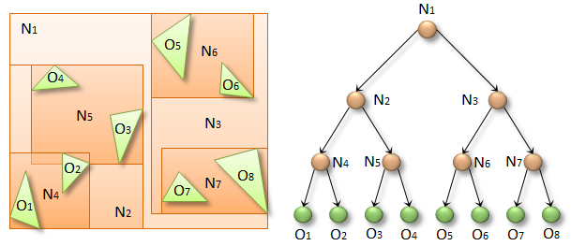
BVH Basics
A tree-like data structure
The leaf-nodes of the tree represent the smallest primitive (triangles, or geometric objects
Upper nodes are constructed by building an Axis-Aligned Bounding Box (AABB) over the child nodes
The number of child nodes used to construct the parent node is called the degree of the BVH
Notes:
The image shows an example of a 2-degree BVH

Slide 23
BVH Construction
The leaf nodes are constructed by taking 32 lights from the sorted list
The AABB for the first child nodes are constructed by performing a reduction on the leaf nodes
The upper levels are constructed by performing a reduction on the child nodes
Process is repeated until only the root node remains
Notes:
In the first phase, the AABBs for the lowest level child nodes of the BVH are computed. This is done by reading the AABB of 32 primitives and reducing them to a single AABB that encloses all 32 primitives.
In the second phase of the BVH construction, the upper nodes of the BVH are built.
The upper nodes of the BVH are constructed in a similar manner to the child nodes. The primary difference between these two phases is the source of the AABB in the first phase is derived from the scene primitives and in the second phase the AABBs are derived from the lower child nodes of the BVH.

Slide 24
BVH Traversal
The term cell refers to the area that is being checked for overlap
Uses a stack to push the index of the child node of the BVH if the AABB of the node overlaps with the AABB of the cell
32-threads in a warp each perform the AABB intersection test during traversal
If it is a leaf node, the AABB of the lights is checked against the AABB of the cell
Notes:
The method to traverse the BVH uses a stack to push the index of the child node in the BVH if the AABB of the child node overlaps with the cell.
A thread group of 32 threads is dispatched for each cell in the scene.
Each thread checks a child node of the BVH.
If the AABB of the BVH node overlaps with the AABB of the cell, the index of the BVH node is pushed onto the stack.
If the traversal reaches the leaf nodes, then the AABB of the primitives are checked if they intersect with the AABB of the cell.
The first thread of each warp pops a node off the stack and the process continues until the stack is empty.

Slide 25
Volume Tiled Forward Shading
Initialize
Determine Grid Size
Compute AABBs for Volume Tiles
Update
Depth pre-pass
Mark tiles
Find unique tiles
Assign lights to tiles
Shade samples

Slide 26

Determine Grid Size
Volume tiles are defined in view space
Only need to be recomputed if the screen resolution changes or field-of-view changes
For a given tile size $(t_{x},t_{y})$ and screen dimensions $(w,h)$, the number of subdivisions $(S_{x},S_{y})$ is
$$\left(S_{x},S_{y}\right)=\left(\left\lceil \frac{w}{t_{x}}\right\rceil ,\left\lceil \frac{h}{t_{y}}\right\rceil \right)$$
And the number of subdivisions in the depth is
$$S_{z}=\left\lfloor \frac{\log\left({z_{far}}/{z_{near}}\right)}{\log\left(1+\frac{2tan⁡(θ)}{S_{y}}\right)}\right\rfloor$$
Notes:
The subdivisions in the depth formula is taken from Ola Olsson et. al. for Clustered shading.
To convert a logarithm to another base, simply divide the natural logarithm of the base.
Log_b(a) = log_e(a) / log_e(b)

Slide 27

Compute AABBs
The AABB for a volume tile is the minimum bounding volume that fully encloses the frustum created by the tile
$$\begin{matrix}k_{near} & = & z_{near}{\left(1+\frac{2\tan\left(θ\right)}{S_{y}}\right)}^{k} \\ k_{far} & = & z_{near}{\left(1+\frac{2\tan\left(θ\right)}{S_{y}}\right)}^{k+1} \\ p_{min} & = & \left(S_{x}∙i,S_{y}∙j\right) \\ p_{max} & = & \left(S_{x}∙\left(i+1\right),S_{y}∙\left(j+1\right)\right)\end{matrix}$$

Slide 28
Depth Pre-pass
Record all of the opaque scene objects into the depth buffer
Required to ensure only visible samples are drawn in the next pass…
Notes:
The depth pre-pass ensures that only the tiles containing visible samples will be activated in the next pass.

Slide 29
Mark Active Tiles
For each visible sample (pixel shader invocation), mark the volume tile corresponding to the sample
This results in a sparse list of flags corresponding to “active” tiles
A dense list of tile IDs is generated in the next pass
Notes:
Suppose you had a list of active tiles. You still need to produce a dense list of tile ID’s. This is the next step…

Slide 30

Build Tile List
Compress the list of active tiles
Produces a dense list of tile IDs
$$[2,8,14,18,24,25,26,27,28,29,40,⋯]$$
Notes:
For example, the tile list shown in the previous slide would produce the following list of dense tiles.
This simply requires an atomic append to a list in a compute shader.

Slide 31
Assign Lights to Tiles
A thread group is executed per active volume tile
Uses Indirect Dispatch to make sure only enough thread groups are executed (without needing to stall the GPU)
An AABB-AABB test is performed against the AABB of the volume tile for each light in the scene (brute-force)
If the BVH of the lights is available, use that to reduce the number of tests that need to be performed
Results in a volume tile grid and a global light index list
Notes:
A single slice of the volume light grid (A).
The light grid stores the light count and an offset into the light index list (B).
The light index list stores the index of the light source in the light list (C).
Indirect Dispatch allows you to specify the dispatch arguments in a compute shader.
The number of active tiles is only known after the list of unique tiles is built.
To avoid needing to read the result of the number of active tiles before the Dispatch API call can be invoked on the CPU, an indirect dispatch is invoked passing the GPU buffer containing the number of tiles as an argument.
This means that the number of active tiles never needs to be read from the GPU to the CPU, avoiding an expensive GPU stall.

Slide 32
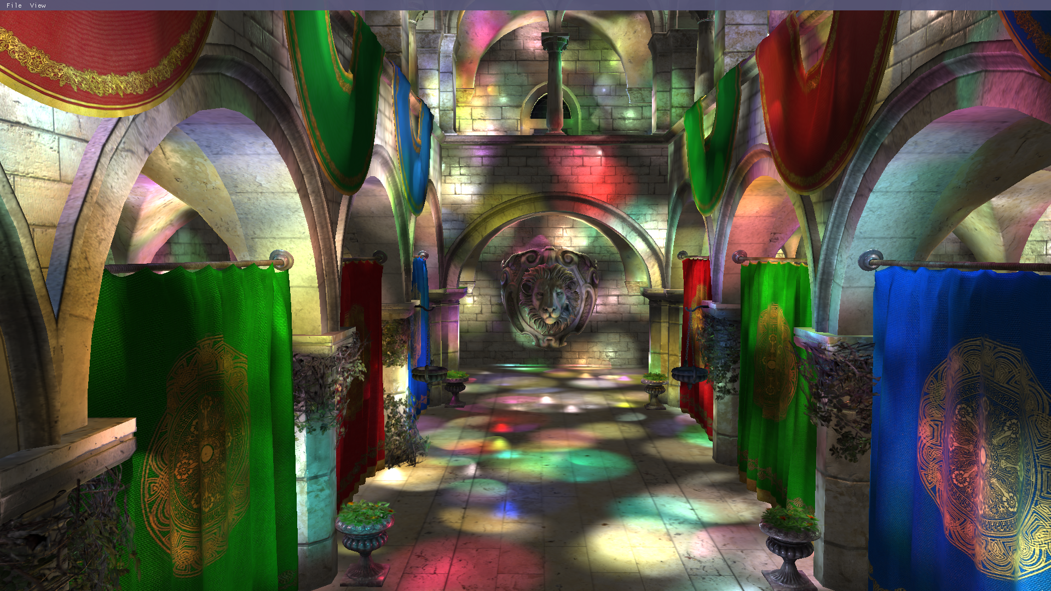
Shade Samples
Same as Forward rendering but only the lights intersecting with the current volume tile are considered during shading
Notes:
Same technique for shading as forward rendering, and tiled forward shading.
The number of lights and the offset in the global light index list is retrieved from the volume tile grid (previous slide).

Slide 33
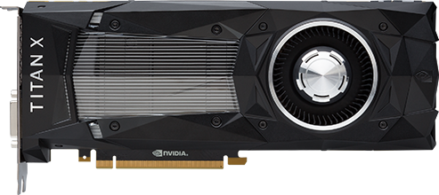
Experiment Setup
DirectX 12 Graphics API
Targeted for Windows 10
NVidia GeForce GTX Titan X was used for all experiments (complements of NVidia)
Scenes used
Sponza atrium (Crytek, 2010)
San Miguel hacienda (McGuire, 2011)
Tested Algorithms
Forward Rendering
Tiled Forward Shading
Volume Tiled Forward Shading
Volume Tiled Forward Shading with BVH
Captured using GPU timestamp queries
All times reported in milliseconds (ms)

Slide 34
Results
Forward Rendering (FR)
Tiled Forward Shading (TFS)
Volume Tiled Forward Shading (VTFS)
Volume Tiled Forward Shading with BVH (VTFSBVH)
Comparison

Slide 35
Forward Rendering (Sponza)
Notes:
Can achieve about 250 lights in “real-time”.

Slide 36
Forward Rendering (San Miguel)
Notes:
Passes the “real-time” threshold with only 50 lights.

Slide 37
Tiled Forward Shading (Sponza)
Notes:
When ensuring constant light density, can achieve 100,000 lights in real-time.
Here we see the light culling stage is taking up all the time!

Slide 38
VTFS (Sponza)
Notes:
Also cross the “real-time” threshold with just over 100,000 lights.
Again, the “Assign lights to tiles” is taking up all the time.

Slide 39
VTFS (San Miguel)
Notes:
Crosses “real-time” at just over 32,768 lights.
Assign lights to tiles is again the most depending phase.

Slide 40
VTFSBVH (Sponza)
Notes:
With a constant light density, able to achieve 4 M lights with real-time frame rates.
Sorting becomes the new bottleneck.

Slide 41
VTFSBVH (San Migule)
Notes:
This scene is harder to render. Crosses the line at 1.5 M lights.
Lots of active tiles due to the transparencies in the tree and plants in this scene.

Slide 42
Techniques Combined (Sponza)
Notes:
While maintaining a constant light density, VTFSBVH outperform all other techniques achieving 4 M light sources in real-time.

Slide 43
Techniques Combined (San Miguel)
Notes:
VTFSBVH outperforms with more than 16,384 light sources and has a very desirable performance profile with more lights.

Slide 44
Known Issues
Reducing Draw Calls
Self-Similar Volume Tiles

Slide 45
Reducing Draw Calls
Volume Tiled Forward Shading requires several render passes
3 x opaque objects (Depth pre-pass, mark active tiles, shading)
2 x transparent objects (mark active tiles, shading)
API overhead can be mitigated using indirect draw
Vertex feedback buffers can be used to avoid expensive animation and tessellation stages

Slide 46
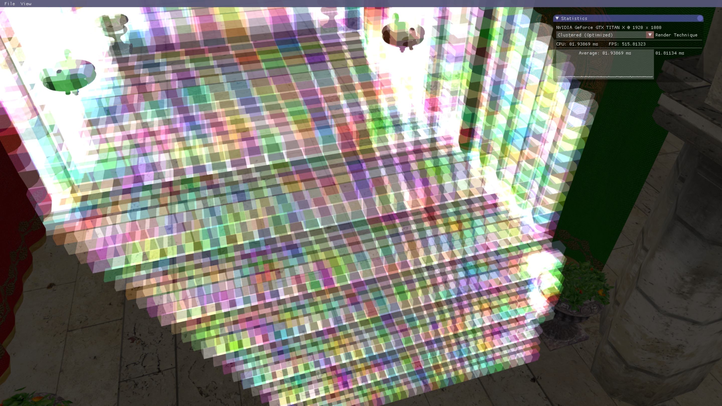
Self-Similar Volume Tiles
Volume tiles close to the camera are relatively small
Volume tiles further away become larger
This is done to make tiles as cubic as possible but results in larger volume tiles covering many lights
May improve culling if the min/max bounds of visible samples are used to reduce the size of the volume tile
Notes:
May be able to use the min/max bounds of all samples within a volume tile to reduce the size of the volume tile, thus minimizing the number of lights contained in the volume tile.

Slide 47
Improved Sorting
Sorting is the bottleneck of the technique
Difficult to solve the sorting problem efficiently
May try to experiment with different sorting techniques on the GPU
Maybe Merge sort alone will work better than Radix sort (if done properly)
Notes:
If the Merge sort algorithm can be properly optimized, maybe it can work better than radix sort?

Slide 48

Conclusion
Volume Tiled Forward Shading performs better than Tiled Forward Shading when more than 16,384 lights are active in the scene
Can handle 4 M active lights (with a constant light distribution of $1 light/unit^{3}$
May be improved by improving sorting
Shading may be improved by limiting the volume tile AABB by the range of samples contained in the volume tile

Slide 49
Questions?

Slide 50
References
Akeley, K., Akin, A., Ashbaugh, B., Beretta, B., Carmack, J., & Craighead, M. et al. (2007). ARB_vertex_program. Opengl.org. Retrieved 23 September 2016, from https://www.opengl.org/registry/specs/ARB/vertex_program.txt
AMD Graphics Cores Next (GCN) Architecture. (2012) (1st ed.). Retrieved from https://www.amd.com/Documents/GCN_Architecture_whitepaper.pdf
Andersson, J. (2009). Parallel Graphics in Frostbite – Current & Future. Presentation, Siggraph.
Balestra, C., & Engstad, P. (2008). The technology of uncharted: Drake’s fortune. Presentation, Game Developer Conference.
Beretta, B., Brown, P., Craighead, M., Everitt, C., Hart, E., & Leech, J. et al. (2013). ARB_fragment_program. OpenGL.org. Retrieved 23 September 2016, from https://www.opengl.org/registry/specs/ARB/fragment_program.txt
Blelloch, G. (1989). Scans as primitive parallel operations. IEEE Transactions On Computers, 38(11), 1526-1538. http://dx.doi.org/10.1109/12.42122
Catmull, E. (1974). A Subdivision Algorithm for Computer Display of Curved Surfaces (Ph.D). University of Utah.
Clark, J. (1976). Hierarchical geometric models for visible surface algorithms. Communications Of The ACM, 19(10), 547-554. http://dx.doi.org/10.1145/360349.360354
CUDA C Best Practices Guide. (2016) (1st ed.). Retrieved from http://docs.nvidia.com/cuda/pdf/CUDA_C_Best_Practices_Guide.pdf
Deering, M., Winner, S., Schediwy, B., Duffy, C., & Hunt, N. (1988). The triangle processor and normal vector shader. ACM SIGGRAPH Computer Graphics, 22(4), 21-30. http://dx.doi.org/10.1145/378456.378468
Dickau, R. (2008). Lebesgue 3D curve, iteration 2. Retrieved from https://commons.wikimedia.org/wiki/File:Lebesgue-3d-step2.png
Downloads. (2017). Crytek.com. Retrieved 4 January 2017, from http://www.crytek.com/cryengine/cryengine3/downloads
Ericson, C. (2005). Real-time collision detection. Amsterdam: Elsevier.
Foley, J., van Dam, A., Feiner, S., & Hughes, J. (1996). Computer Graphics: Principles and Practice (2nd ed.). Boston: Addison-Wesley.
Geldreich, R., & Pritchard, M. (2004). GDC Vault - Deferred Shading on DX9 Class Hardware and the Xbox. Gdcvault.com. Retrieved 27 September 2016, from http://www.gdcvault.com/play/1015172/Deferred-Shading-on-DX9-Class
Green, O., McColl, R., & Bader, D. (2012). GPU merge path. Proceedings Of The 26Th ACM International Conference On Supercomputing - ICS '12. http://dx.doi.org/10.1145/2304576.2304621
Harada, T. (2012). A 2.5D culling for Forward+. SIGGRAPH Asia 2012 Technical Briefs On - SA '12. http://dx.doi.org/10.1145/2407746.2407764
Harada, T., McKee, J., & Yang, J. (2012). Forward+: Bringing Deferred Lighting to the Next Level.
Hargreaves, S., & Harris, M. (2004). Deferred Shading. Presentation.

Slide 51
References
Harris, M., Sengupta, S., & Owens, J. (2008). Parallel Prefix Sum (Scan) with CUDA. In H. Nguyen, GPU Gems 3 (1st ed., pp. 871-873). Addison-Wesley.
Hillis, W., & Steele, G. (1986). Data parallel algorithms. Communications Of The ACM, 29(12), 1170-1183. http://dx.doi.org/10.1145/7902.7903
Howes, L. (2012). Making GPGPU Easier - Software and Hardware Improvements in GPU Computing. Presentation, University of Texas, Austin, Texas.
Karras, T. (2012). Thinking Parallel, Part II: Tree Traversal on the GPU. Parallel Forall. Retrieved 5 January 2017, from https://devblogs.nvidia.com/parallelforall/thinking-parallel-part-ii-tree-traversal-gpu/
Lottes, T. (2009). FXAA. Santa Clara, California, USA: NVIDIA Corporation. Retrieved from http://developer.download.nvidia.com/assets/gamedev/files/sdk/11/FXAA_WhitePaper.pdf
McGuire, M. (2011). Meshes. Graphics.cs.williams.edu. Retrieved 2 June 2017, from http://graphics.cs.williams.edu/data/meshes.xml
McKee, J. (2012). Technology Behind AMD's "Leo Demo". Presentation, San Francisco, California.
Mittring, M. (2009). A bit more deferred - CryEngine 3. Presentation, Raleigh, North Carolina.
Morton, G. (1966). A computer oriented geodetic data base and a new technique in file sequencing (1st ed.). Ottawa: International Business Machines Co.
NVIDIA GeForce GTX 1080 Whitepaper. (2016) (1st ed.). Retrieved from http://international.download.nvidia.com/geforce-com/international/pdfs/GeForce_GTX_1080_Whitepaper_FINAL.pdf
Olsson, O. (2015). Introduction to Real-Time Shading with Many Lights. Presentation.
Olsson, O., & Assarsson, U. (2011). Tiled Shading. Journal Of Graphics, GPU, And Game Tools, 15(4), 235-251. http://dx.doi.org/10.1080/2151237x.2011.621761
Olsson, O., Billeter, M., & Assarsson, U. (2012). Clustered Deferred and Forward Shading. In Eurographics/ ACM SIGGRAPH Symposium on High Performance Graphics. Eurographics: The Eurographics Association. Retrieved from http://dx.doi.org/10.2312/EGGH/HPG12/087-096
Programming Guide :: CUDA Toolkit Documentation. (2016). Docs.nvidia.com. Retrieved 13 January 2017, from https://docs.nvidia.com/cuda/cuda-c-programming-guide/index.html
Rasterization Rules (Windows). (2017). Msdn.microsoft.com. Retrieved 10 July 2017, from https://msdn.microsoft.com/en-us/library/windows/desktop/cc627092(v=vs.85).aspx#Multisample
Saito, T., & Takahashi, T. (1990). Comprehensible rendering of 3-D shapes. ACM SIGGRAPH Computer Graphics, 24(4), 197-206. http://dx.doi.org/10.1145/97880.97901
SAT (Separating Axis Theorem) – dyn4j. (2017). Dyn4j.org. Retrieved 10 July 2017, from http://www.dyn4j.org/2010/01/sat/
Satish, N., Harris, M., & Garland, M. (2009). Designing efficient sorting algorithms for manycore GPUs. 2009 IEEE International Symposium On Parallel & Distributed Processing. http://dx.doi.org/10.1109/ipdps.2009.5161005

Slide 52
References
Segal, M., & Akeley, K. (1994). The OpenGL Graphics System: A Specification (1st ed.). Silicon Graphics, Inc. Retrieved from https://www.opengl.org/registry/doc/glspec10.pdf
Segal, M., & Akeley, K. (2004). The OpenGL Graphics System: A Specification (2nd ed.). Silicon Graphics Inc. Retrieved from https://www.opengl.org/registry/doc/glspec20.20041022.pdf
Shishkovtsov, O. (2006). Deferred Shading in S.T.A.L.K.E.R. In M. Pharr & R. Fernando, GPU Gems 2: Programming Techniques For High-Performance Graphics And General-Purpose Computation (3rd ed.). Pearson Addison Wesley Prof. Retrieved from http://http.developer.nvidia.com/GPUGems2/gpugems2_chapter09.html
Singer, G. (2013). The History of the Modern Graphics Processor. TechSpot. Retrieved 2 September 2016, from http://www.techspot.com/article/650-history-of-the-gpu
van der Leeuw, M. (2007). Deferred Rendering in Killzone 2. Presentation, Palo Alto, California.
van Oosten, J. (2011). Optimizing CUDA Applications - 3D Game Engine Programming. 3D Game Engine Programming. Retrieved 6 January 2017, from http://www.3dgep.com/optimizing-cuda-applications/
van Oosten, J. (2014). Introduction to DirectX 11. 3D Game Engine Programming. Retrieved 21 September 2016, from http://www.3dgep.com/introduction-to-directx-11
van Oosten, J. (2015). Forward vs Deferred vs Forward+ Rendering with DirectX 11. 3D Game Engine Programming. Retrieved 29 September 2016, from http://www.3dgep.com/forward-plus
Wilt, N. (2013). The CUDA Handbook: A Comprehensive Guide to GPU Programming (1st ed., pp. 365-383). Addison-Wesley.
Young, E. (2010). DirectCompute Optimizations and Best Practices. Presentation, San Jose, California.
Zhang, H., Manocha, D., Hudson, T., & Hoff, K. (1997). Visibility culling using hierarchical occlusion maps. Proceedings Of The 24Th Annual Conference On Computer Graphics And Interactive Techniques - SIGGRAPH '97. http://dx.doi.org/10.1145/258734.258781

